Slide 1
Introduction to Perfecto

Slide 2
Introducing Perfecto
Setting the bar for market success
Partnering with Enterprises to deliver exceptional digital experiences
Dominant leader & visionary
“Perfecto Mobile marks shift in mobile apps quality with Continuous Quality Lab”
Strong Ecosystem
Founded in late 2006, Business HQ in Boston
Over 300 employees globally
Fortune 500 customer base
Perfecto
@ a glance

Slide 3
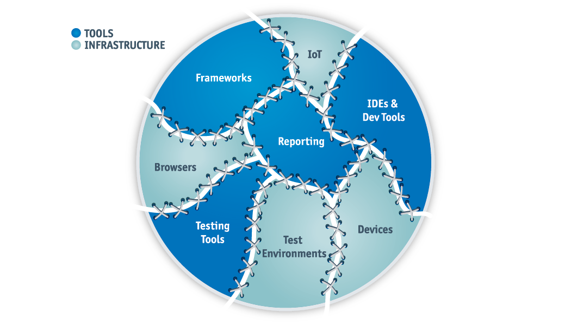
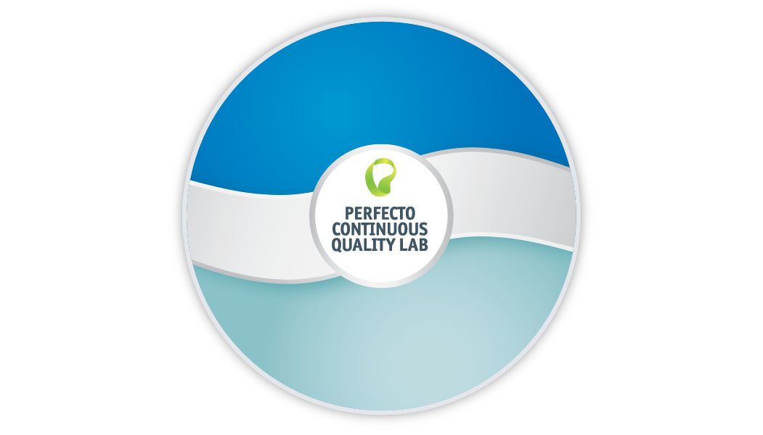
Purpose Built Solution: DIY vs. Perfecto
“Stitched Together” Architecture
Unified Architecture
Notes:
Without Perfecto
Typically, companies end up with an architecture that “stitches together” a number of disconnected tools and infrastructure components. For instance, they might have different labs for mobile and web testing, with separate reporting frameworks. Such a disjointed architecture leads to teams spending significant amounts of time creating and then maintaining integrations between tools and underlying infrastructure. Over time these integrations become yet another time consuming non-core activity, which negatively impacts their ability to achieve high velocity and quality of digital delivery.
Perfecto’s Architecture
By contrast, Perfecto’s Continuous Quality Lab has been architected from the ground up as a cohesive platform unifying DevOps tools and underlying test infrastructure. For instance, with Perfecto, both mobile and web resources are part of one global lab. All test results are aggregated in one pane of glass - Perfecto’s DigitalZoom reporting portal. The portal delivers a unified digital quality view, accelerating feedback loops and digital delivery at scale.

Slide 4
Perfecto – Platform for Continuous Testing as a Service
Test
Analytics
DigitalZoom® - Open Reporting & Analytics
Continuous Testing Reports
Continuous Integration Analysis
Root Cause Analysis
PaaS
For
Testing
Automation & Lab Management
Test Creation
Automation Coverage Extension (ACE)
Making open source enterprise grade
Test Orchestration & Execution
Open Source Framework
DevOps Bridge™
BDD
Platform Mgt
Open {REST:API}
Parallel Execution
WindTunnel™ – Test Environment
Platform Connectivity Layer™ (PCL)
Digital
IaaS
Enterprise Grade Cloud Infrastructure
Desktops
Browsers
Mobile Devices
IoT
One Cloud Lab Covering All Digital Platforms
Notes:
Perfecto’s Continuous Quality Lab is comprised of three parts: the lab infrastructure, test automation and test analytics. All three are exposed via a REST API for easy integration within enterprise DevOps toolchains. The Lab provides managed digital apps testing resources as a service. This is complemented by test automation capabilities that enable creating configurable test environments that mirror customers worldwide. Perfecto’s open approach extends open source tools enabling enterprises to match market speed. Test automation is more than creating scripts and executing with a lab. Quantum is an end to end framework encompassing authoring, execution and analytics.
Quantum enables
Easy environment setup - lab access, user authentication, and driver management.
Test creation - BDD for easy-to-use English phrased steps and application objects, and for Java-skilled users, a more simple to use environment.
Result analysis - Perfecto Reporting incorporated into the test for analysis of test execution, with no intervention required by the test writer.
Data Driven mechanism - Support in commonly used data formats, like XML and CSV.
Device management - Supports smart wait for devices, including queuing and retry mechanisms.
Perfecto pre-defined BDD steps - Including all Perfecto Mobile actions as Java and Cucumber utilities.

Slide 5
One Lab Architected for Digital Quality at High Velocity
One Enterprise Grade Cloud total reliability, unlimited scale, secure, compliant, global and available 24/7
Platform Connectivity Layer™ (PCL) architecture
Complete digital platform coverage
Same day support for production and beta versions
DevOps Bridge Plugins and APIs enable quality activities across the SDLC
Automation Coverage Extensions™ (ACE) extend open source to achieve high degree of automation
WindTunnel™ Layer persona-based user environment testing for true digital coverage
DigitalZoom™ Reporting provides cross platform visibility and fast drill down
Maximize Digital Test
Coverage
Maximize % of Automation
Fast Feedback
Loop
Integrated Lab Across Dev-Test-Ops
FOUR PILLARS OF SUCCESS
Notes:
Objective: Establish our unique value core differentiators
Example:
How is our lab different than alternatives?
There are six key capabilities that make our lab
uniquely capable to satisfy all four pillars of success
They are: <read> and supplement with below
Cloud is not hosting devices. It’s much more than that.
We connect to platforms differently than anyone else. This removes flakiness and barriers to high automation.
One lab for responsive web is an example, multiple screen sizes can be tested using the same script across both mobile and desktop browsers.
Our solution is architected to allows us to detach our lab from the interface – allowing the lab to be embedded across tools
We are the only vendor with the ability to perform persona based testing, defined as a parameter in you test scripts. We decouple the persona conditions form the test case, allowing the same test to be run across different personas (with different network, location, background apps, etc).
It is unique in that no reporting tool on the market provides a comprehensive digital view with the flexibility to see digital platform in one view, and zoom in to the point of failure, by platform/and step in the flow.

Slide 6
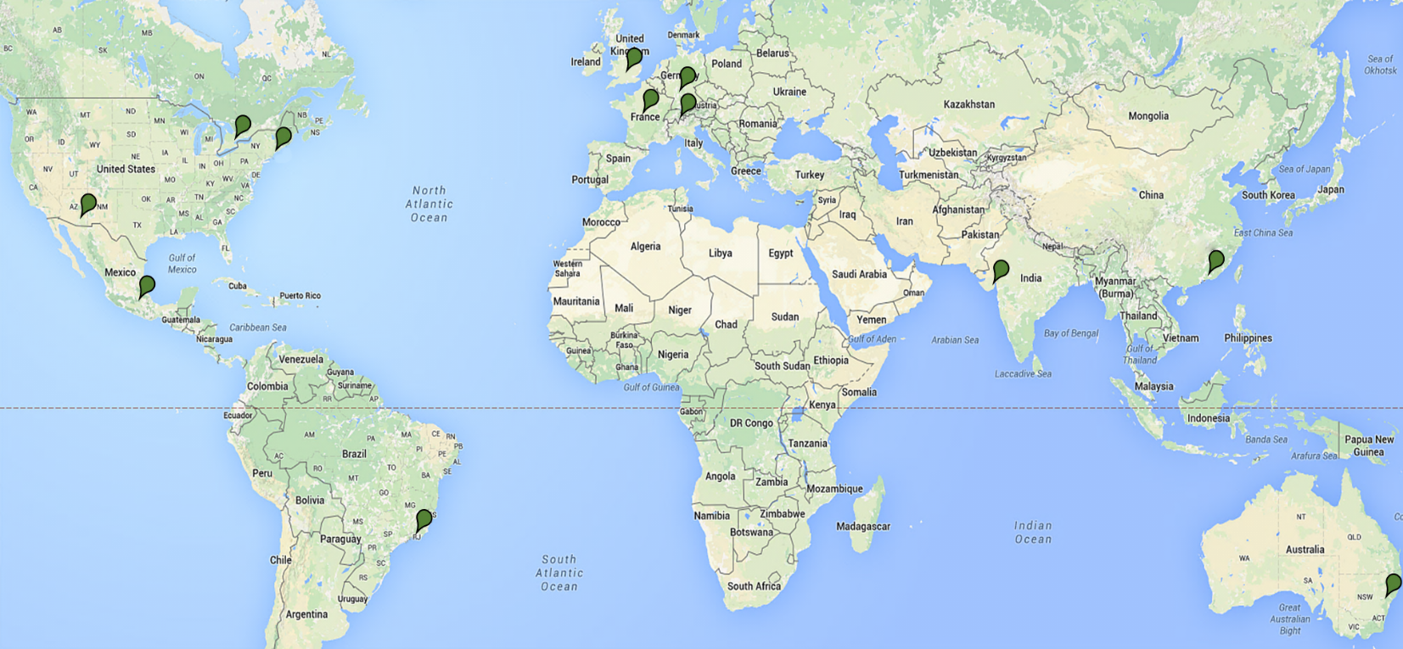
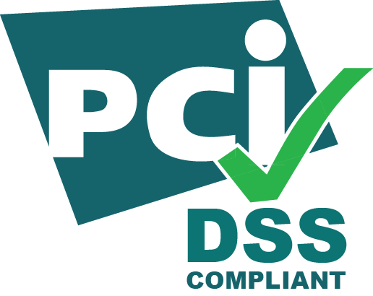
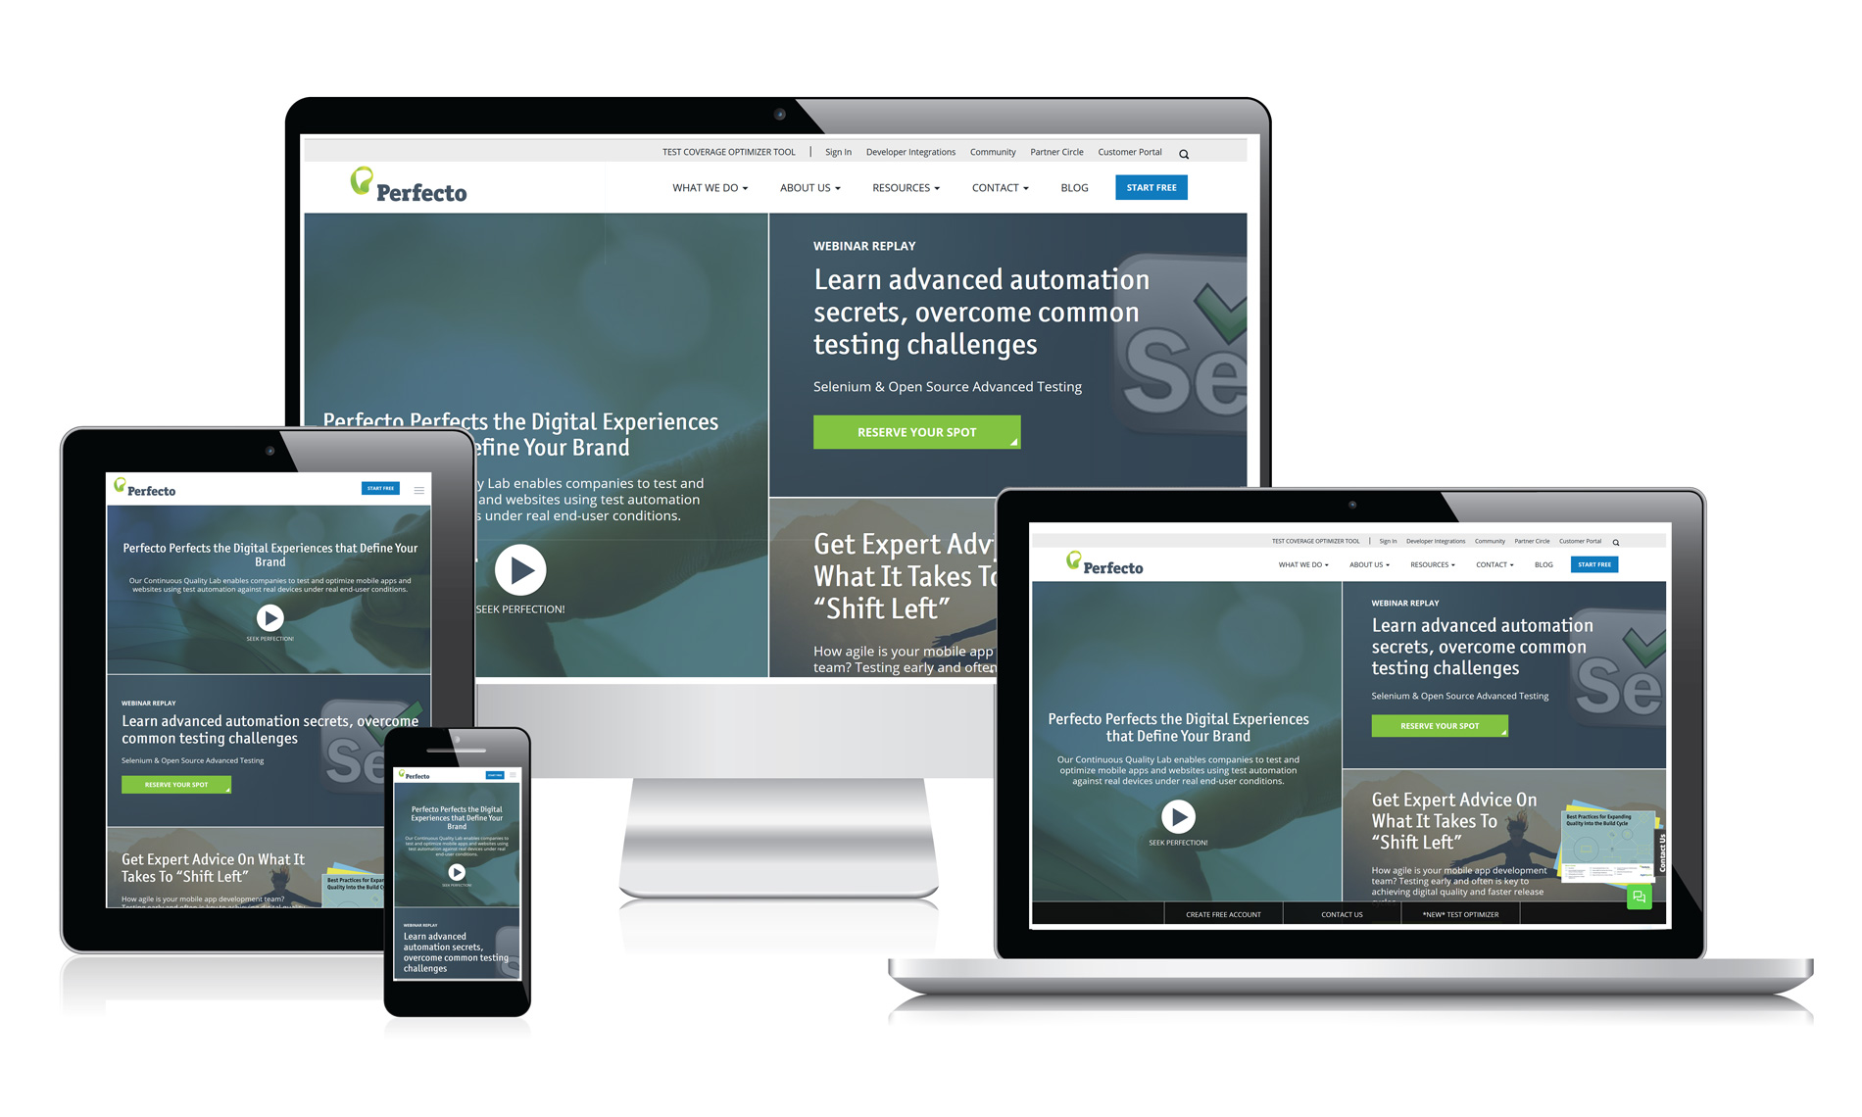
Enterprise Grade Cloud
14 Global data centers
Uncompromised Security
Network Operations team
Support Desk
Infrastructure monitoring
24x7
Unlimited Platform Scalability
High Availability architecture
Auto recovery
Data recovery
World Class
Hosted ≠ Cloud
Notes:
Example:
Cloud-first architecture does not equal hosted
devices. To achieve the four pillars, you need
all of these elements. (review slide)
Additional Notes:
Perfecto is compliant with various certifications and third-party attestations. These include:
SSAE16. This report includes detailed controls Perfecto operates along with an independent auditor opinion about the effective operation of those controls.
PCI DSS Level 1. Perfecto has been independently validated to comply with the PCI Data Security Standard as a shared host service provider.
ISO 27001. Perfecto has achieved ISO 27001 certification of the Information Security Management System (ISMS) covering infrastructure, data centers, and services.
HIPAA. Perfecto is compliant with HIPPA’s Security and Privacy Rules.
US/EU Privacy Shield. Perfecto maintains compliance with the 2016 EU data privacy law (formerly Safe Harbor). The EU-U.S. Privacy Shield Framework was designed by the U.S. Department of Commerce and European Commission to provide companies on both sides of the Atlantic with a mechanism to comply with EU data protection requirements when transferring personal data from the European Union to the United States in support of transatlantic commerce.
Germany Data Privacy. No export of data outside of EU. New facilities scheduled for Q1 2017. The German Bundesdatenschutzgesetz (BDSG) is a Federal data protection act, that together with the data protection acts of the German federal states and other area-specific regulations, governs the exposure of personal data, which are manually processed or stored in IT systems.

Slide 7
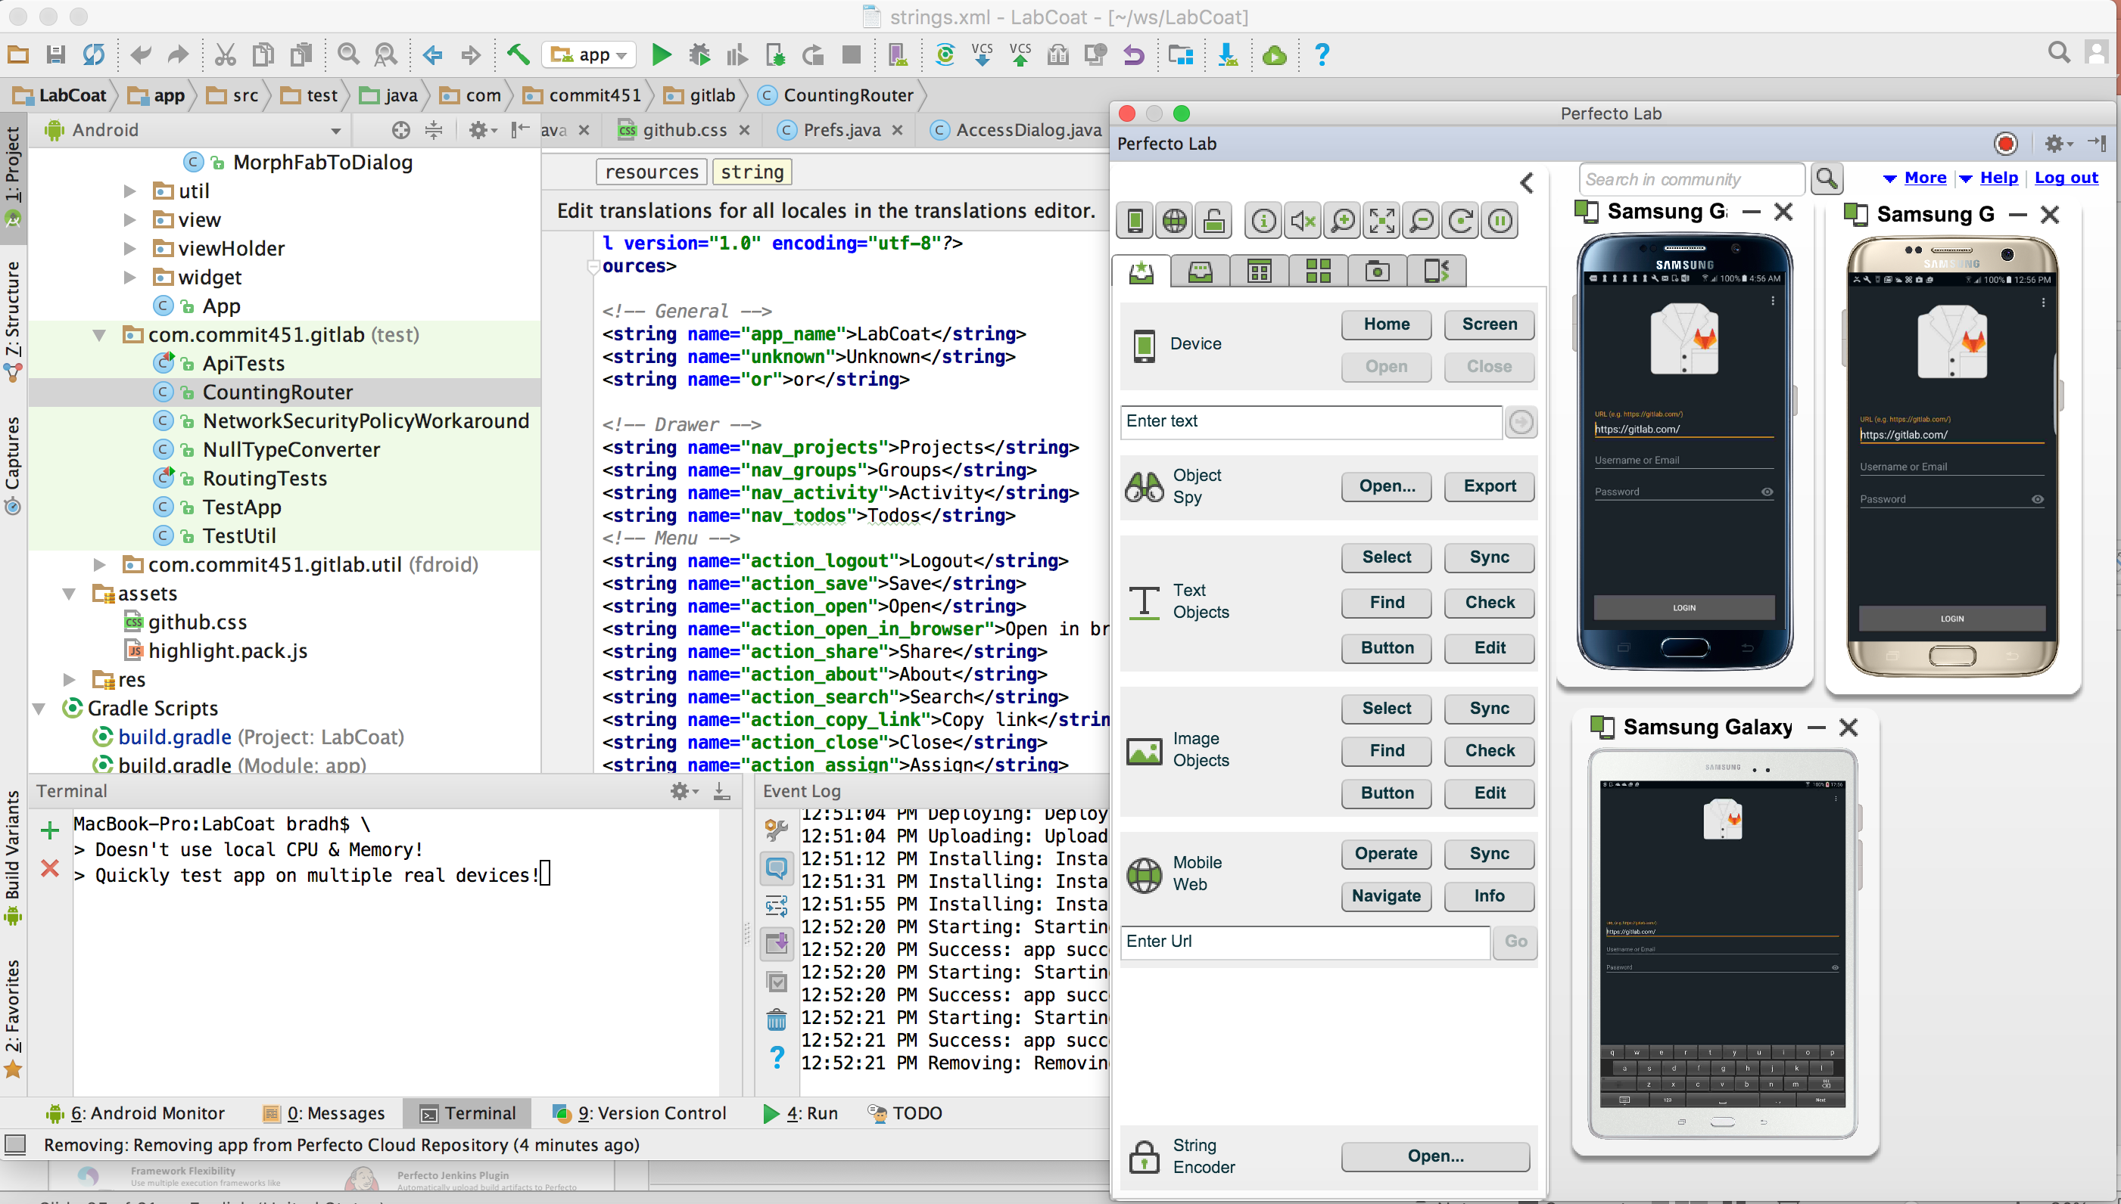
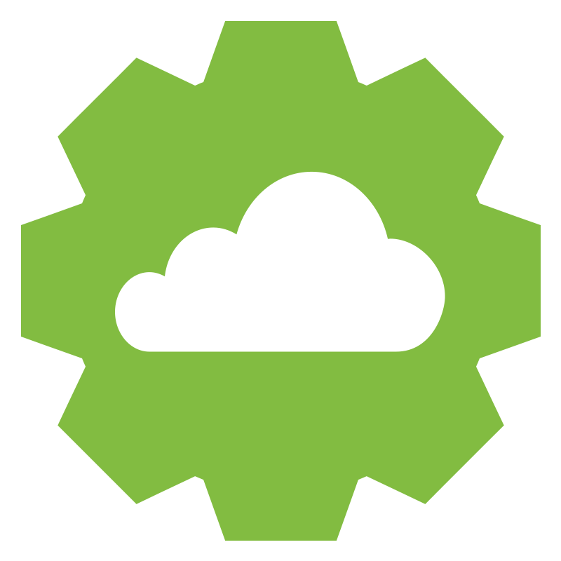
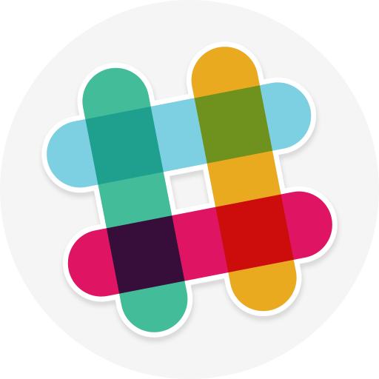
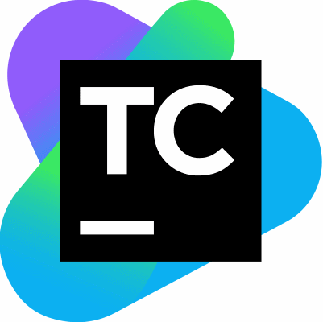
DevOps Bridge: Increasing Toolchain Efficiency
Bring the test lab into the Dev Environment
Bi-Directional Test Results API
Integrated into your DevOps pipeline
In
Out
+
Rest API
Debug with DevTunnel
IDE Plugins
Quality Visibility: One Pane of Glass
One Quality Platform – Fully Integrated
Notes:
For quality, tool chain efficiency speaks to several items – the ability for automation developers to use the same UI for writing app and test code; the ability to import and export quality data from other tools. (for example, Splunk or test NG). To achieve velocity test automation must be integrated into build automation (CI) strategies.
Our lab is integrated into the developer workflow. Developers can develop code and run it on real devices, in the cloud, and validate and debug code, interactively with existing tools, without distracting context switching between different tools. Immediate feedback, as I work.
Our architecture difference allows us to integrate into any environment, across SDLC teams. This is hard to do, and needs to be built into the lab from the beginning to be accessed as a cloud solution, from anywhere.

Slide 8
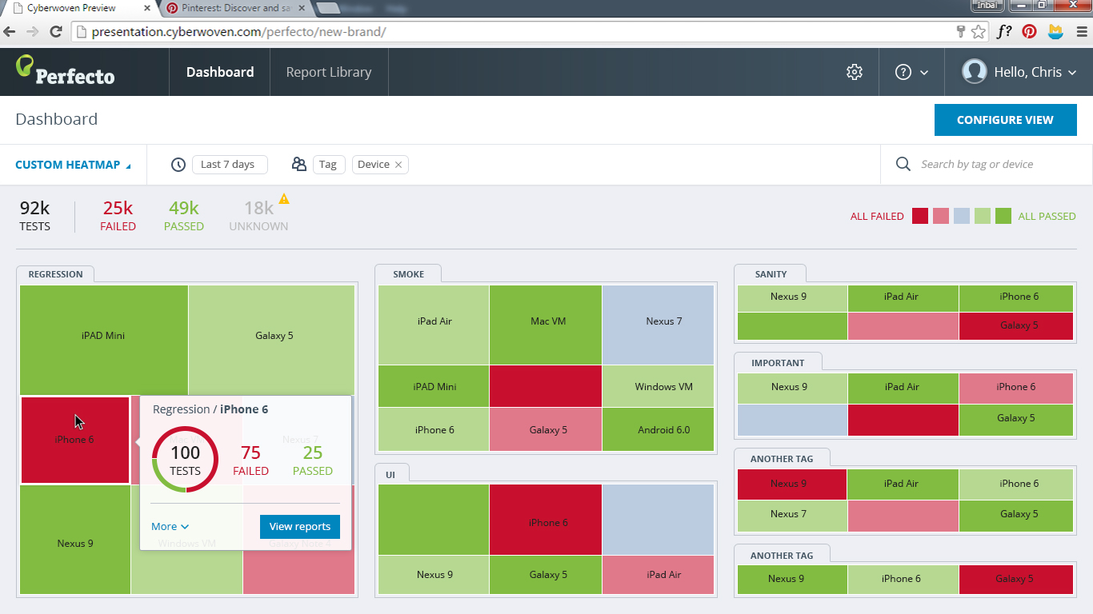
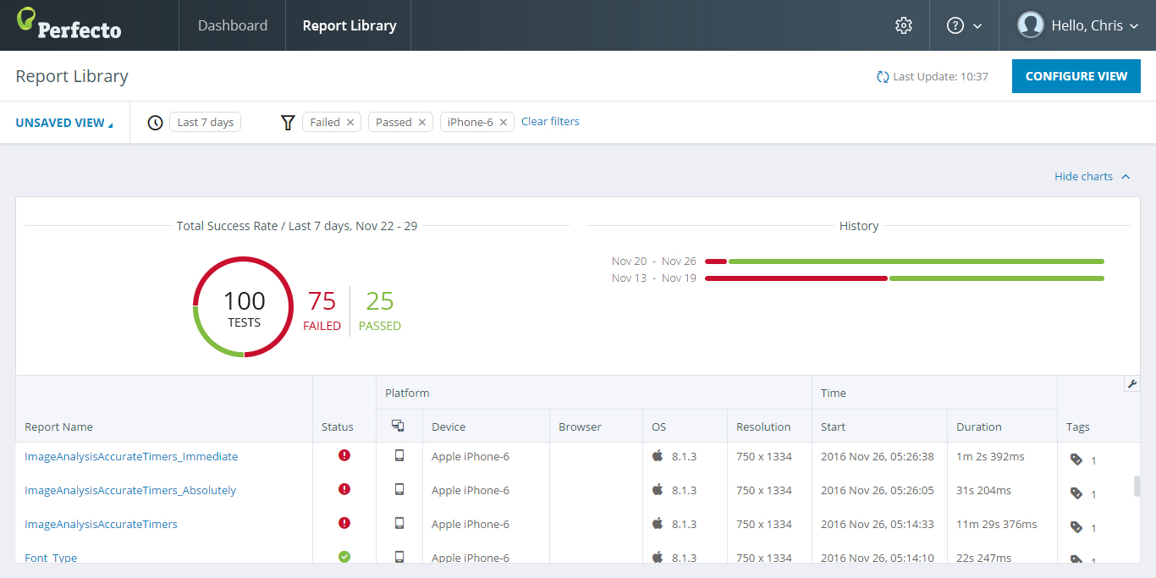
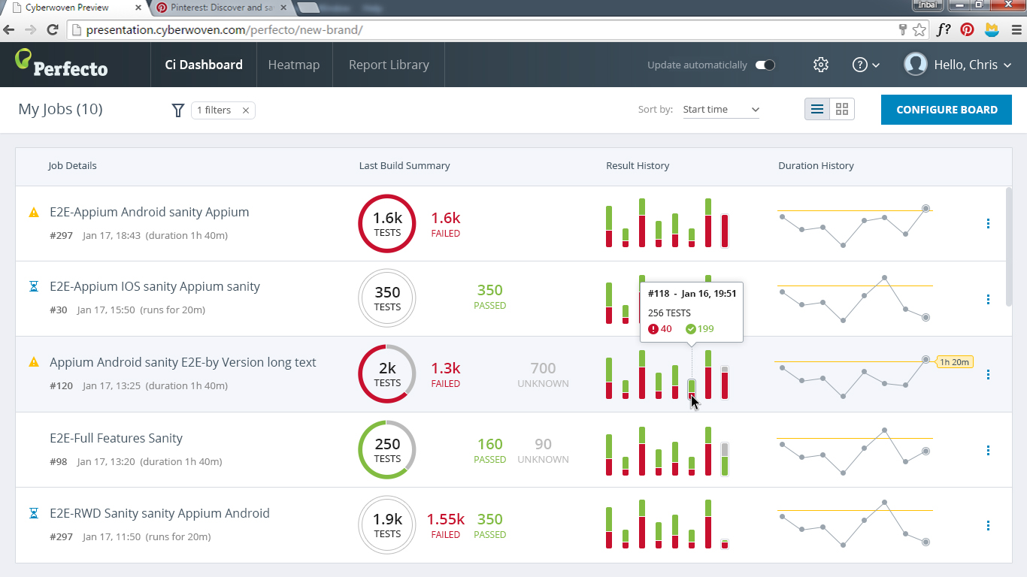
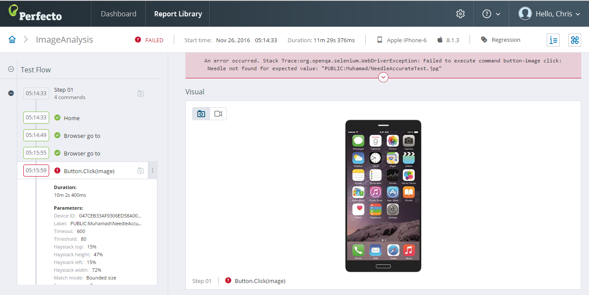
DigitalZoom™ Reports - Visibility, Traceability, Fast Analysis
CI Jobs
Health Trend
One cloud BI Reporting system from executive to root cause analysis for engineers
Team/Project level real-time application health dashboard with trending
Full Flexibility to view any granularity with full traceability between reporting levels
Out-of-the-box digital relevant filters + filter customization
Collaboration capabilities for remote joint analysis
Digital View
Fast analysis
Fast feedback loop
Notes:
Example:
Frequency and volume of testing is going up.
The result is a bottleneck being created in the
form of test results that need to be reported on.
For example, Paycheck spends two man-days stitching together reports for management.
ESPN reported that they limited their test cases to what they could analyze within their release window, limiting their coverage, and not running all test the could because reporting capability limited their ability to use the test results in any meaningful way.
What is the view of your quality across digital platforms? At the test suite level? At the test step where failure occurred?
DigitalZoom is our reporting solution. It is architected for a top to bottom view on digital quality. From a high level view across all digital platforms, to a platform specific view, to the specific test step and device where failure occurred.
DigitalZoom provides:
Full traceability
Full digital platform coverage

Slide 9
One Script, One Lab for all Digital Platforms
Responsive Web Application
One Application logic to test
Multiple Display Sizes
Server side logic
Client side logic (browser)
Platforms / screens sizes
One Responsive Web App
1
All capabilities available to test all platforms (location, network, OCR, visual validation, etc.)
One Script
One Lab
2
Easily compare between platforms (Functional & performance.)
All digital platforms
One coherent test strategy for Responsive Web Apps
Notes:
Example:
Responsive web apps today are tested with two
labs, by two different teams, independently.
One for desktop. One for mobile web. Having different approaches to test the same flow is inefficient.
We offer one solution, with side-by-side testing, in parallel, using the same code for both desktop and mobile browsers.
(point 1) In addition, all capabilities provided for desktop browsers are also available for mobile browser. What about the case were you need to test location?
(point 2) Once the test is run, how quickly can you compare results across mobile and web? We have integrated, side-by-side reporting providing a complete platform view of what passed or failed, why, and where in the testing flow.

Slide 10
Ulta Beauty – Increase eCommerce Revenue - Faster TTM
Challenge
Increase eCommerce Revenue from $200M to $400M
Speed of Innovation – new ideas were taking too long to get to the customer
Goals
Decrease regression time: 160 hours to 12 hours
Increase UI automation from 65% to 90%+
Omni-Channel automation from 0% to 90%+
Performance automation from 0% to 90%+
Annual regressions: 17 to 365 (nightly)
Sprint Duration: 3 weeks to 2 weeks
Key Metrics
Improved test coverage from 65% to 95%
Improved browser coverage by 650%
Reduced regression time by 92%
Before: $200M
2 Browsers / 1 OS / 11 Releases
Bounce Rate: 48%
After: $400M
15 Browsers / 4 OS / 16 Releases
Bounce Rate:<40%

Slide 11
Introduction to Perfecto

